Slide 1


Activities
Android Developer Fundamentals
This work is licensed under a Creative Commons Attribution-NonCommercial 4.0 International License
This work is licensed under a Creative_{Activity Lifecycle &}
Android Developer Fundamentals Commons Attribution-NonCommercial_{Managing State}
4.0 International License
1

Slide 2
Contents
Activity
Activity lifecycle
Activity lifecycle callbacks
Activity instance state
Saving and restoring activity state
This work is licensed under a Creative Commons Attribution-NonCommercial 4.0 International License
2

Slide 3
Activities (high-level view)
_{Activity Lifecycle &} This work is licensed under a Creative
_{Managing State} Commons Attribution-NonCommercial
4.0 International License
Android Developer Fundamentals
3

Slide 4
What is an Activity?
An Activity is an application component
Represents one window, one hierarchy of views
Typically fills the screen, but can be embedded in other activity or a appear as floating window
Java class, typically one activity in one file
This work is licensed under a Creative Commons Attribution-NonCommercial 4.0 International License
4

Slide 5
What does an Activity do?
Represents an activity, such as ordering groceries, sending
email, or getting directions
Handles user interactions, such as button clicks, text entry,
or login verification
Can start other activities in the same or other apps
Has a life cycle—is created, started, runs, is paused, resumed, stopped, and destroyed
This work is licensed under a Creative Commons Attribution-NonCommercial 4.0 International License
5

Slide 6
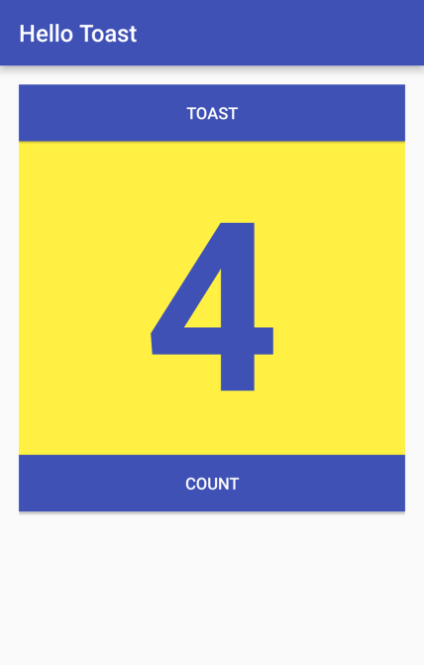
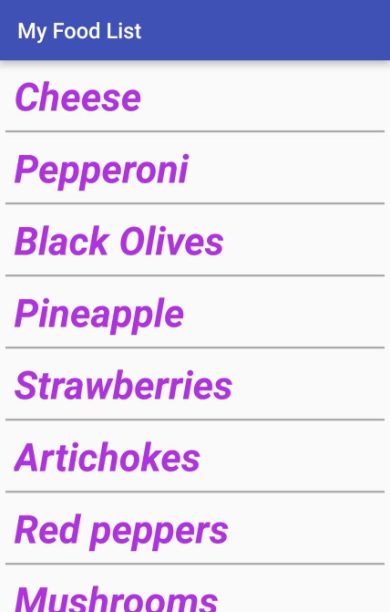
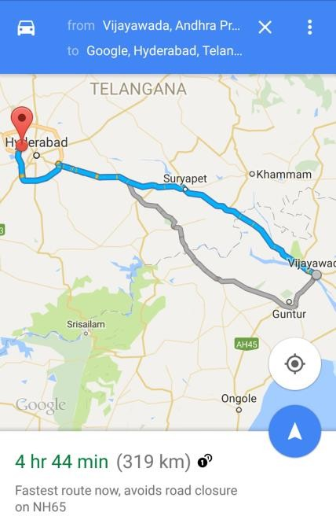
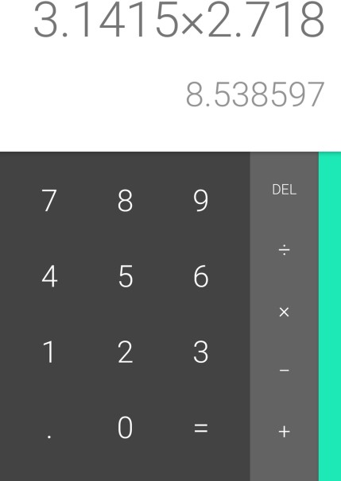
Examples of activities
This work is licensed under a Creative Commons Attribution-NonCommercial 4.0 International License
6

Slide 7
Apps and activities
Activities are loosely tied together to make up an app
First activity user sees is typically called "main activity"
Activities can be organized in parent-child relationships in the Android manifest to aid navigation
This work is licensed under a Creative Commons Attribution-NonCommercial 4.0 International License
7

Slide 8
Layouts and Activities
An activity typically has a UI layout
Layout is usually defined in one or more XML files
Activity "inflates" layout as part of being created
This work is licensed under a Creative Commons Attribution-NonCommercial 4.0 International License
8

Slide 9
Implementing Activities
This work is licensed under a Creative Commons Attribution-NonCommercial 4.0 International License
9

Slide 10
Implement new activities
Define layout in XML
Define Activity Java class
extends AppCompatActivity
Connect Activity with Layout
Set content view in onCreate()
Declare Activity in the Android manifest
This work is licensed under a Creative Commons Attribution-NonCommercial 4.0 International License
10

Slide 11
1. Define layout in XML
<?xml version="1.0" encoding="utf-8"?>
<RelativeLayout xmlns:android="http://schemas.android.com/apk/res/android" android:layout_width="match_parent" android:layout_height="match_parent">
<TextView
android:layout_width="wrap_content" android:layout_height="wrap_content" android:text="Let's Shop for Food!" />
</RelativeLayout>
This work is licensed under a Creative Commons Attribution-NonCommercial 4.0 International License
11

Slide 12
2. Define Activity Java class
public class MainActivity extends AppCompatActivity {
@Override
protected void onCreate(Bundle savedInstanceState) { super.onCreate(savedInstanceState);
}
}
This work is licensed under a Creative Commons Attribution-NonCommercial 4.0 International License
12

Slide 13
3. Connect activity with layout
public class MainActivity extends AppCompatActivity { @Override
protected void onCreate(Bundle savedInstanceState) { super.onCreate(savedInstanceState);
setContentView(R.layout.activity_main);
Resource is layout in this XML file
}
}
This work is licensed under a Creative Commons Attribution-NonCommercial 4.0 International License
13

Slide 14
4. Declare activity in Android manifest
<activity android:name=".MainActivity">
This work is licensed under a Creative Commons Attribution-NonCommercial 4.0 International License
14

Slide 15
4. Declare main activity in manifest
Main Activity needs to include intent to start from launcher icon
<activity android:name=".MainActivity">
<intent-filter>
<action android:name="android.intent.action.MAIN" />
<category android:name="android.intent.category.LAUNCHER" />
</intent-filter>
</activity>
This work is licensed under a Creative Commons Attribution-NonCommercial 4.0 International License
15

Slide 16

2.2 Activity Lifecycle and Managing State
This work is licensed under a Creative Commons Attribution-NonCommercial 4.0 International License
16

Slide 17
Activity Lifecycle
Android Developer Fundamentals
17

Slide 18
What is the Activity Lifecycle?
The set of states an activity can be in during its lifetime, from when it is created until it is destroyed
More formally:
A directed graph of all the states an activity can be in, and the callbacks associated with transitioning from each state to the next one
This work is licensed under a Creative Commons Attribution-NonCommercial 4.0 International License

Slide 19
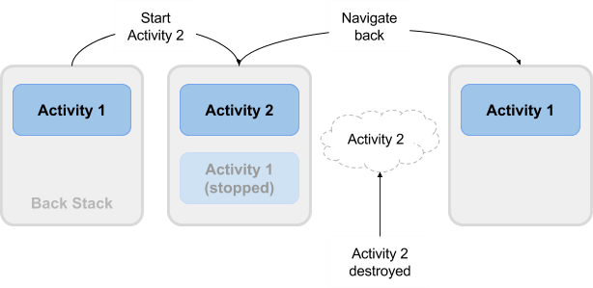
What is the Activity Lifecycle?
This work is licensed under a Creative Commons Attribution-NonCommercial 4.0 International License

Slide 20
Activity states and app visibility
Created (not visible yet)
Started (visible)
Resume (visible)
Paused(partially invisible)
Stopped (hidden)
Destroyed (gone from memory)
State changes are triggered by user action, configuration changes such as device rotation, or system action
This work is licensed under a Creative Commons Attribution-NonCommercial 4.0 International License

Slide 21
Callbacks and when they are called
onCreate(Bundle savedInstanceState)—static initialization
onStart()—when activity (screen) is becoming visible
onRestart()—called if activity was stopped (calls onStart())
onResume()—start to interact with user
onPause()—about to resume PREVIOUS activity
onStop()—no longer visible, but still exists and all state info preserved
onDestroy()—final call before Android system destroys activity
This work is licensed under a Creative Commons Attribution-NonCommercial 4.0 International License

Slide 22
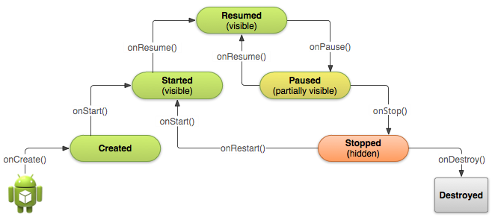
Activity states and callbacks graph
This work is licensed under a Creative Commons Attribution-NonCommercial 4.0 International License

Slide 23
Implementing and overriding callbacks
Only onCreate() is required
Override the other callbacks to change default behavior
This work is licensed under a Creative Commons Attribution-NonCommercial 4.0 International License

Slide 24
onCreate() –> Created
Called when the activity is first created, for example when
user taps launcher icon
Does all static setup: create views, bind data to lists, ...
Only called once during an activity's lifetime
Takes a Bundle with activity's previously frozen state, if
there was one
Created state is always followed by onStart()
This work is licensed under a Creative Commons Attribution-NonCommercial 4.0 International License

Slide 25
onCreate(Bundle savedInstanceState)
@Override
public void onCreate(Bundle savedInstanceState) {
super.onCreate(savedInstanceState);
// The activity is being created.
}
This work is licensed under a Creative Commons Attribution-NonCommercial 4.0 International License

Slide 26
onStart() –> Started
Called when the activity is becoming visible to user
Can be called more than once during lifecycle
Followed by onResume() if the activity comes to the foreground, or onStop() if it becomes hidden
This work is licensed under a Creative Commons Attribution-NonCommercial 4.0 International License

Slide 27
onStart()
@Override
protected void onStart() {
super.onStart();
// The activity is about to become visible.
}
This work is licensed under a Creative Commons Attribution-NonCommercial 4.0 International License

Slide 28
onRestart() –> Started
Called after activity has been stopped, immediately before it is started again
Transient state
Always followed by onStart()
This work is licensed under a Creative Commons Attribution-NonCommercial 4.0 International License

Slide 29
onRestart()
@Override
protected void onRestart() {
super.onRestart();
// The activity is between stopped and started.
}
This work is licensed under a Creative Commons Attribution-NonCommercial 4.0 International License

Slide 30
onResume() –> Resumed/Running
Called when activity will start interacting with user
Activity has moved to top of the activity stack
Starts accepting user input
Running state
Always followed by onPause()
This work is licensed under a Creative Commons Attribution-NonCommercial 4.0 International License

Slide 31
onResume()
@Override
protected void onResume() {
super.onResume();
// The activity has become visible
// it is now "resumed"
}
This work is licensed under a Creative Commons Attribution-NonCommercial 4.0 International License

Slide 32
onPause() –> Paused
Called when system is about to resume a previous activity
The activity is partly visible but user is leaving the activity
Typically used to commit unsaved changes to persistent data, stop
animations and anything that consumes resources
Implementations must be fast because the next activity is not resumed until this method returns
Followed by either onResume() if the activity returns back to the front, or onStop() if it becomes invisible to the user
This work is licensed under a Creative Commons Attribution-NonCommercial 4.0 International License

Slide 33
onPause()
@Override
protected void onPause() { super.onPause();
// Another activity is taking focus
// this activity is about to be "paused"
}
This work is licensed under a Creative Commons Attribution-NonCommercial 4.0 International License

Slide 34
onStop() –> Stopped
Called when the activity is no longer visible to the user
New activity is being started, an existing one is brought in front of this one, or this one is being destroyed
Operations that were too heavy-weight for onPause
Followed by either onRestart() if this activity is coming back to interact with the user, or onDestroy() if this activity is going away
This work is licensed under a Creative Commons Attribution-NonCommercial 4.0 International License

Slide 35
onStop()
@Override
protected void onStop() {
super.onStop();
// The activity is no longer visible
// it is now "stopped"
}
This work is licensed under a Creative Commons Attribution-NonCommercial 4.0 International License

Slide 36
onDestroy() –> Destroyed
Final call before activity is destroyed
User navigates back to previous activity, or configuration changes
Activity is finishing or system is destroying it to save space
Call isFinishing() method to check
System may destroy activity without calling this, so use
onPause() or onStop() to save data or state
This work is licensed under a Creative Commons Attribution-NonCommercial 4.0 International License

Slide 37
onDestroy()
@Override
protected void onDestroy() {
super.onDestroy();
// The activity is about to be destroyed.
}
This work is licensed under a Creative Commons Attribution-NonCommercial 4.0 International License

Slide 38
Activity Instance State
Android Developer Fundamentals
38

Slide 39
When does config change?
Configuration changes, invalidate the current layout or other resources in your activity when the user:
rotates the device
chooses different system language, so locale changes
enters multi-window mode (Android 7)
This work is licensed under a Creative Commons Attribution-NonCommercial 4.0 International License
39

Slide 40
What happens on config change?
On configuration change, Android:
shuts down activity by calling:
onPause()
onStop()
onDestroy()
2. then starts it over
by calling:
onCreate()
onStart()
onResume()
This work is licensed under a Creative Commons Attribution-NonCommercial 4.0 International License
40

Slide 41
Activity instance state
State information is created while the activity is running, such as a counter, user text, animation progression
State is lost when device is rotated, language changes, back-button is pressed, or the system clears memory
This work is licensed under a Creative Commons Attribution-NonCommercial 4.0 International License
41

Slide 42
Activity instance state
System only saves:
State of views with unique ID (android:id) such as text entered into EditText
Intent that started activity and data in its extras
You are responsible for saving other activity and user progress data
This work is licensed under a Creative Commons Attribution-NonCommercial 4.0 International License
42

Slide 43
Saving instance state
Implement onSaveInstanceState() in your activity
called by Android runtime when there is a possibility the activity may be destroyed
saves data only for this instance of the activity during current session
This work is licensed under a Creative Commons Attribution-NonCommercial 4.0 International License
43

Slide 44
onSaveInstanceState(Bundle outState)
@Override
public void onSaveInstanceState(Bundle outState) { super.onSaveInstanceState(outState);
// Add information for saving HelloToast counter
// to the outState bundle
outState.putString("count",
String.valueOf(mShowCount.getText()));
}
This work is licensed under a Creative Commons Attribution-NonCommercial 4.0 International License
44

Slide 45
Restoring instance state
Two ways to retrieve the saved Bundle
in onCreate(Bundle mySavedState)
Preferred, to ensure that your user interface, including any
saved state, is back up and running as quickly as possible
Implement callback (called after onStart())
onRestoreInstanceState(Bundle mySavedState)
This work is licensed under a Creative Commons Attribution-NonCommercial 4.0 International License
45

Slide 46
Restoring in onCreate()
@Override
protected void onCreate(Bundle savedInstanceState) { super.onCreate(savedInstanceState); setContentView(R.layout.activity_main);
mShowCount = (TextView) findViewById(R.id.show_count);
if (savedInstanceState != null) {
String count = savedInstanceState.getString("count"); if (mShowCount != null)
mShowCount.setText(count);
}
}
This work is licensed under a Creative Commons Attribution-NonCommercial 4.0 International License
46

Slide 47
onRestoreInstanceState(Bundle state)
@Override
public void onRestoreInstanceState (Bundle mySavedState) { super.onRestoreInstanceState(mySavedState);
if (mySavedState != null) {
String count = mySavedState.getString("count"); if (count != null)
mShowCount.setText(count);
}
}
This work is licensed under a Creative Commons Attribution-NonCommercial 4.0 International License
47

Slide 48
Instance state and app restart
When you stop and restart a new app session, the activity instance states are lost and your activities will revert to their default appearance
If you need to save user data between app sessions, use shared preferences or a database.
This work is licensed under a Creative Commons Attribution-NonCommercial 4.0 International License
48

Slide 49
Learn more
Activity (API Guide)
Activity (API Reference)
Managing the Activity Lifecycle
Pausing and Resuming an Activity
Stopping and Restarting an Activity
Recreating an Activity
Handling Runtime Changes
Bundle
This work is licensed under a Creative Commons Attribution-NonCommercial 4.0 International License
49

Slide 50
What's Next?
Concept Chapter:
2.2 C Activity Lifecycle and Managing State
Practical: 2.2 P Activity Lifecycle and Instance State
This work is licensed under a Creative Commons Attribution-NonCommercial 4.0 International License
50

Slide 51
END
Android Developer Fundamentals
51

